Slide 1




Week-11 (Discussion)
7th October, 2024
Introduction to Machine Learning
Prof. Balaraman Ravindran
Professor and Head of the Department
Department of Data Science and Artificial Intelligence
IIT Madras
Ayan Paul
PMRF Research Scholar
IIT Kharagpur

Slide 2
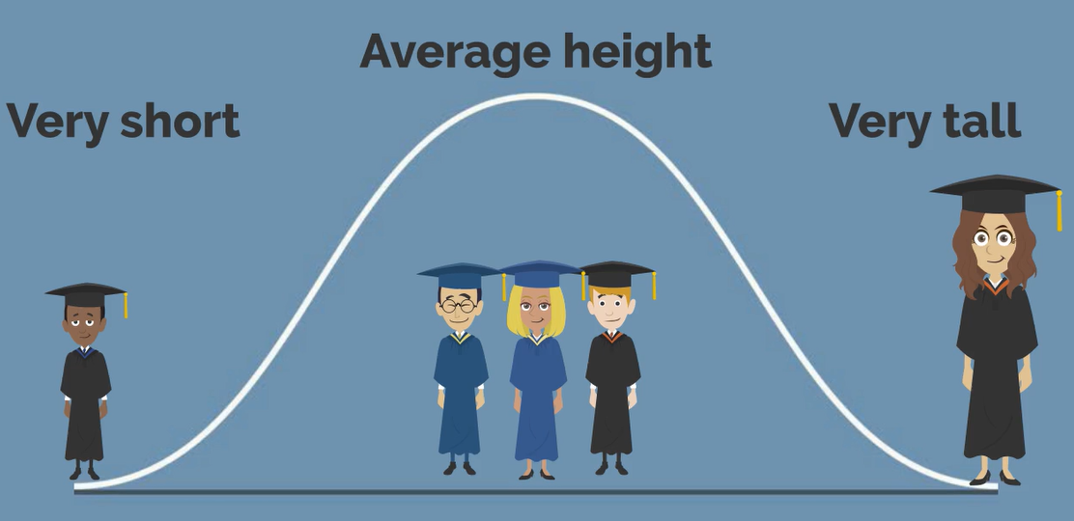
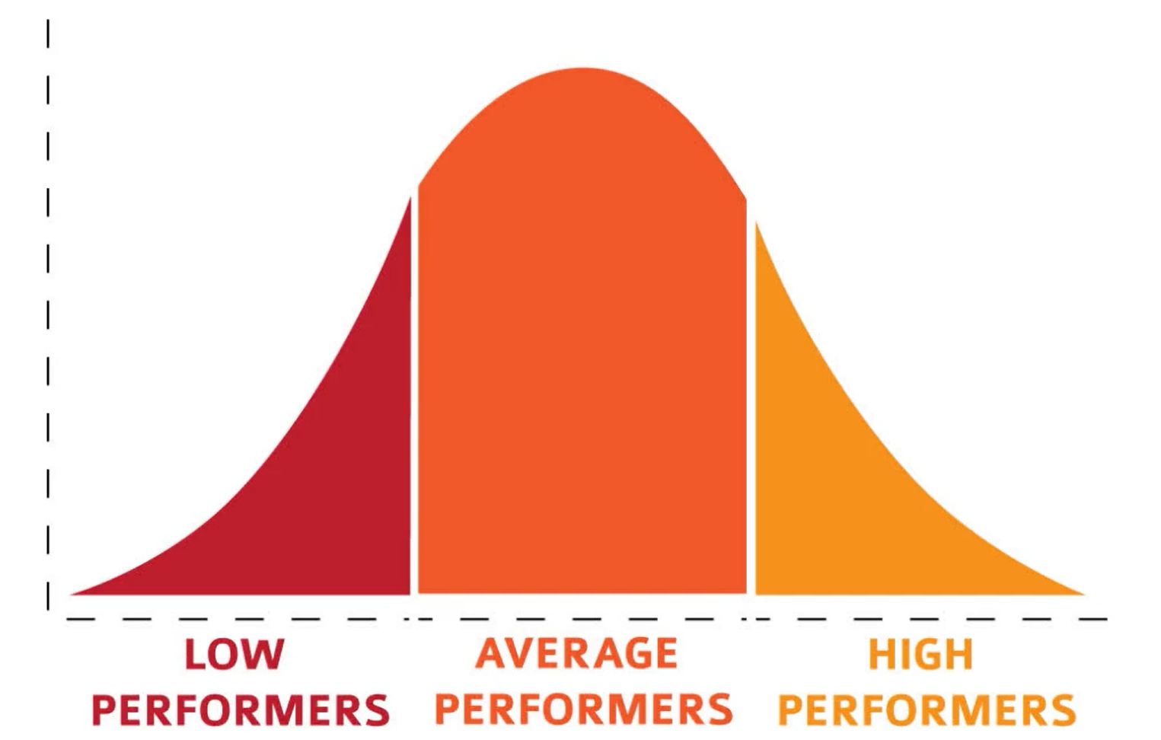
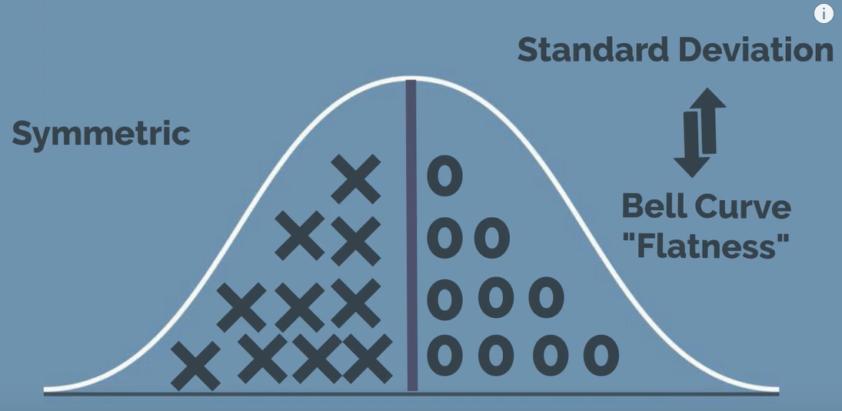
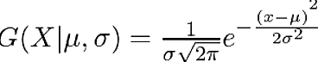


Gaussian Distribution
In probability theory, a normal distribution or Gaussian distribution is a type of continuous probability distribution for a real-valued random variable.
Example of a Gaussian Distribution
In one dimension the probability density function of a Gaussian Distribution is given by
For Multivariate ( let us say d-variate) Gaussian Distribution, the probability density function is given by
Here μ is a d dimensional vector denoting the mean of the distribution and Ʃ is the d X d covariance matrix.

Slide 3

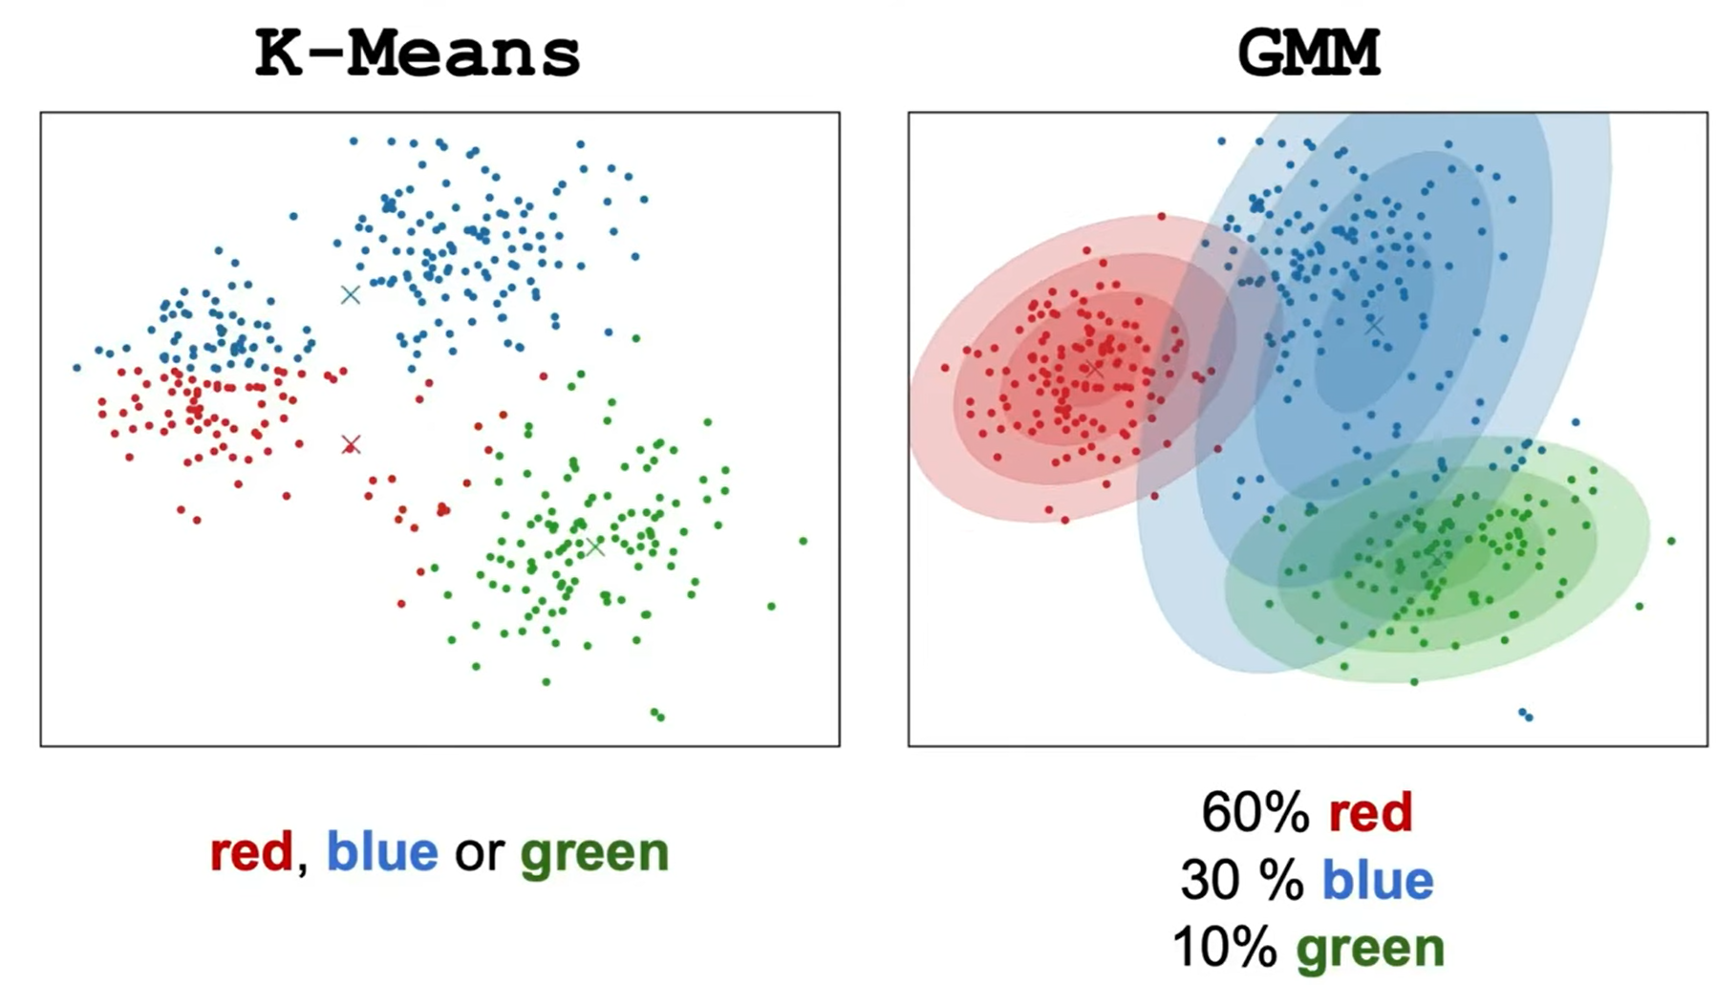

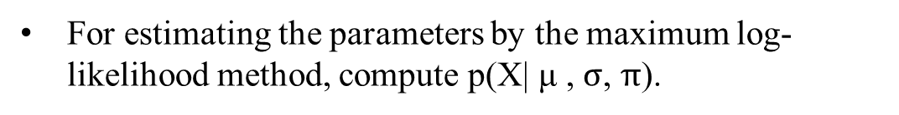
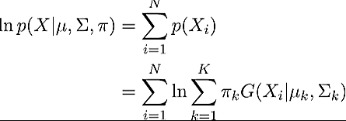
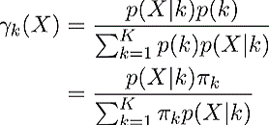


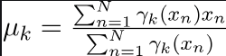
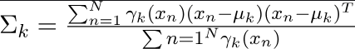
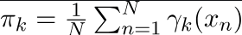
Gaussian Mixture Model
In real life, many datasets can be modeled by Gaussian Distribution.
The Gaussian Mixture Model intuitively assumes that clusters originate from different Gaussian distributions, modeling the dataset as a mixture of these distributions—this forms the core concept of the model.
Suppose there are K clusters, the probability density is defined as a linear function of densities of all these K distributions, i.e.

Slide 4
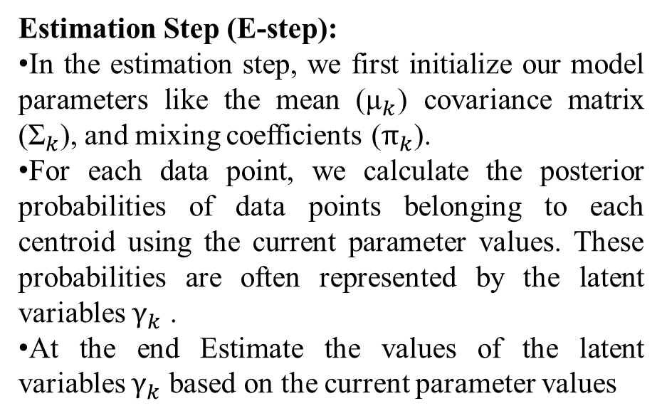
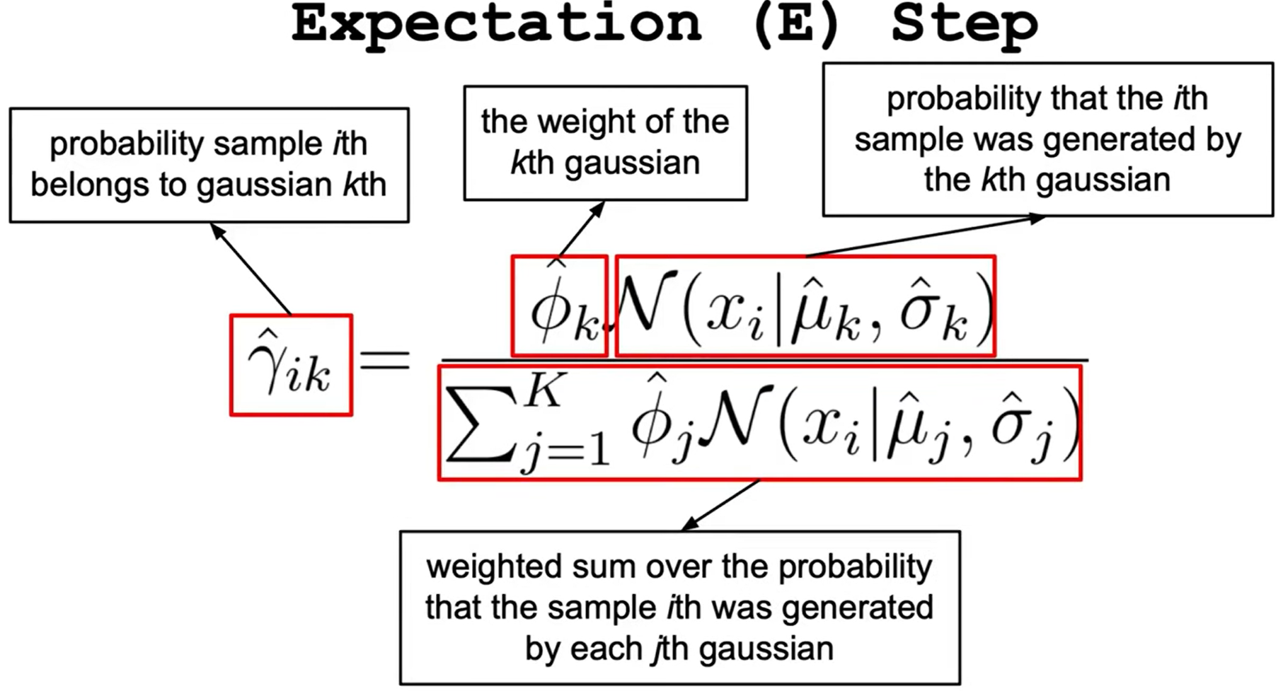
Expectation-Maximization (EM) Algorithm
The Expectation-Maximization (EM) algorithm is an iterative way to find maximum-likelihood estimates for model parameters when the data is incomplete or has some missing data points or has some hidden variables.
EM chooses some random values for the missing data points and estimates a new set of data.
These new values are then recursively used to estimate a better first date, by filling up missing points, until the values get fixed.
π
P
π
P

Slide 5
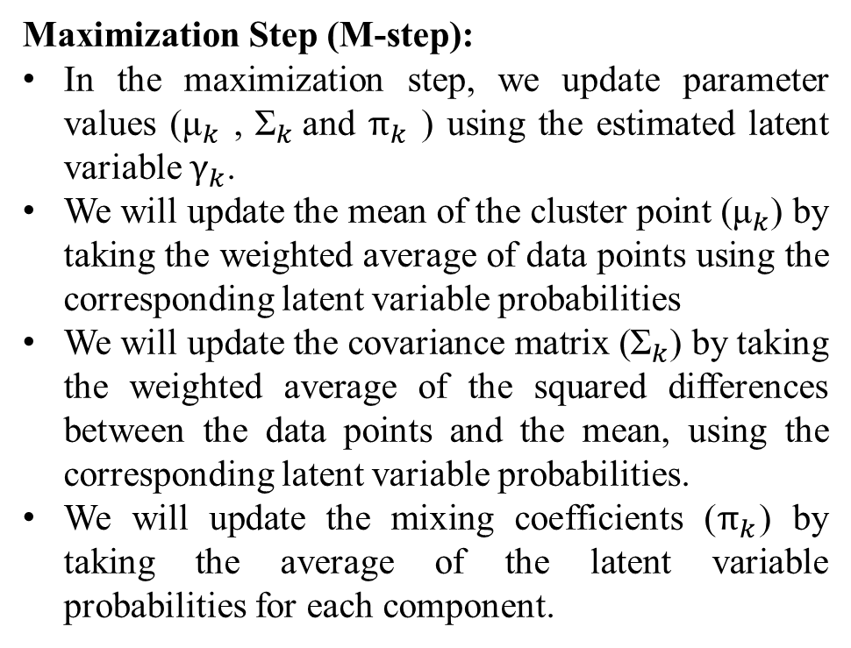
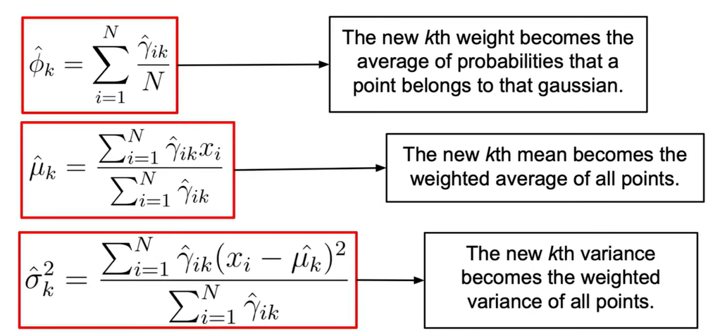
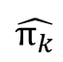
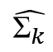
Repeat the E-step and M-step until convergence
We iterate between the estimation step and maximization step until the change in the log-likelihood or the parameters falls below a predefined threshold or until a maximum number of iterations is reached.
Basically, in the estimation step, we update the latent variables based on the current parameter values.
However, in the maximization step, we update the parameter values using the estimated latent variables
This process is iteratively repeated until our model converges.

Slide 6
Topics on which Week 11 Assignment Questions are based
Gaussian Mixture Model
Expectation Maximization

Slide 7
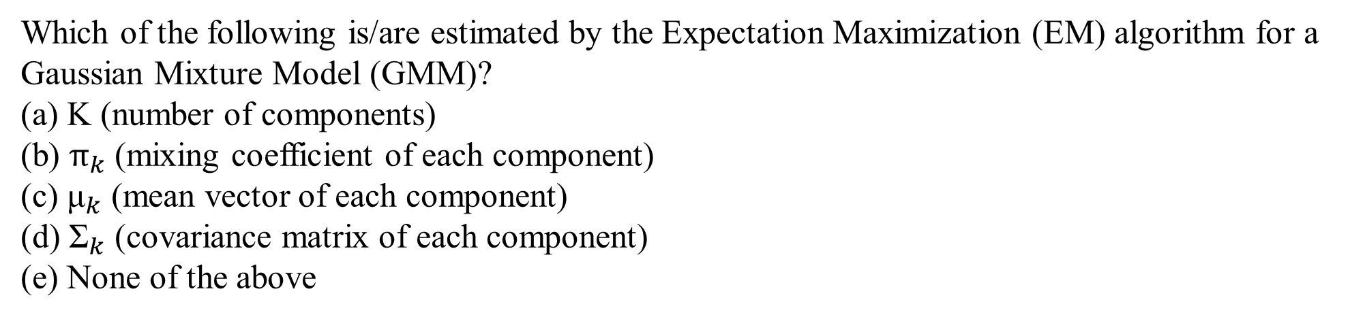
QUESTION 1
SOLUTION 1
The number of components (Gaussian clusters) needs to be predetermined. The EM algorithm estimates the mixing coefficients, mean vectors and covariance matrices.
CORRECT ANSWER 1
b), c), d)

Slide 8
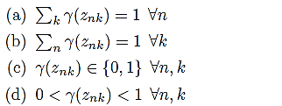
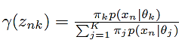
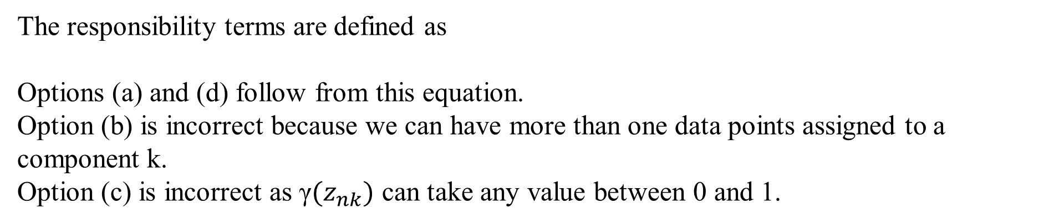
QUESTION 2
Which of the following is/are true about the responsibility terms in GMMs? Assume the
standard notation used in the lectures.
SOLUTION 2
CORRECT ANSWER 2
a), d)

Slide 9
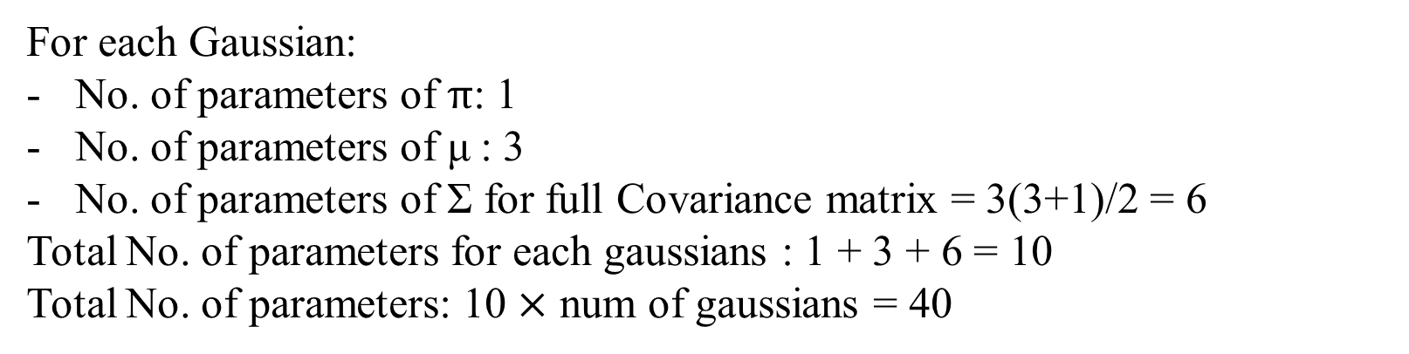
QUESTION 3
Suppose we have a Gaussian mixture model of 3-dimensional data with 4 Gaussians, and we use a model with full covariance matrices. How many parameters are in the model?
a. 30
b. 40
c. 50
d. 60
SOLUTION 3
CORRECT ANSWER 3
b)

Slide 10
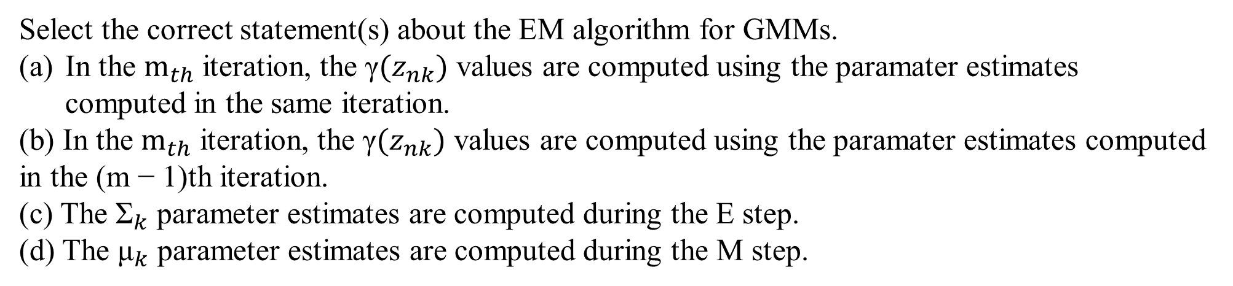
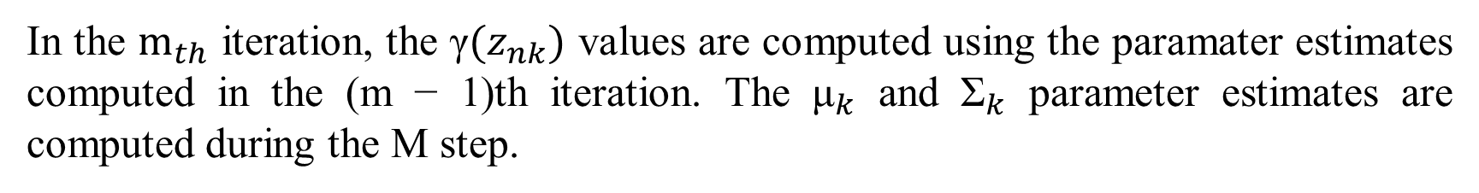
QUESTION 4
SOLUTION 4
CORRECT ANSWER 4
b), d)

Slide 11
QUESTION 5
What does soft clustering mean in GMMs?
There may be samples that are outside of any cluster boundary.
The updates during maximum likelihood are taken in small steps, to guarantee convergence.
It restricts the underlying distribution to be gaussian.
Samples are assigned probabilities of belonging to a cluster.
SOLUTION 5
In soft clustering, instead of assigning each data point into a separate cluster, a probability or likelihood of that point being that cluster is evaluated.
CORRECT ANSWER 5
d)

Slide 12
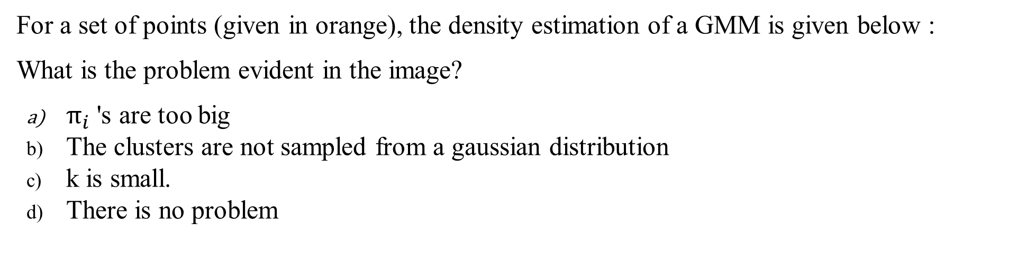
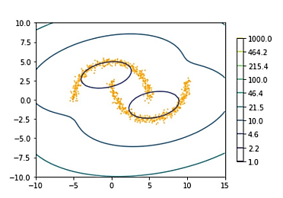
QUESTION 6
SOLUTION 6
The clusters are not sampled from a gaussian distribution. However, increasing k (number of clusters) we can fit the model
CORRECT ANSWER 6
b), c)

Slide 13
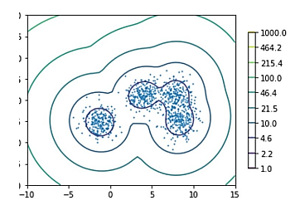
QUESTION 7
For the given GMM model, what is the value of K?
1
2
3
4
5
6
SOLUTION 7
4 Gaussian distributions are formed. As GMM is a soft clustering technique, K=4
CORRECT ANSWER 7
d)

Slide 14
QUESTION 8
Statement A: The Expectation-Maximization (EM) algorithm is used to find maximum-likelihood estimates for model parameters when data is incomplete, missing, or contains hidden variables.
Statement B: The EM algorithm uses random values for the missing data points and iteratively updates these values until they stabilize.
Which of the following is true?
A) Both Statement A and Statement B are true. B) Both Statement A and Statement B are false. C) Statement A is true, but Statement B is false. D) Statement A is false, but Statement B is true.
SOLUTION 8
Both Statement A and Statement B are true
CORRECT ANSWER 8
a)

Slide 15
QUESTION 9
Suppose we are trying to model a p dimensional Gaussian distribution. What is the actual number of independent parameters that need to be estimated?
a) 2
b) p
c) 2p
d) p(p+1)
e) p(p+1)/2
f) p(p+3)/2
SOLUTION 9
For the mean vector, there are p parameters to estimate, one for each dimension.
For the covariance matrix, it's a symmetric matrix of size p by p. Since it's symmetric, only the unique elements need to be specified. There are (p × (p + 1)) / 2 unique elements in a symmetric matrix.
p + (p × (p+1) /2) = (2p + (p × (p+1)) /2) = p (2+p+1) /2 = p(p+3)/2
CORRECT ANSWER 9
d)

Slide 16
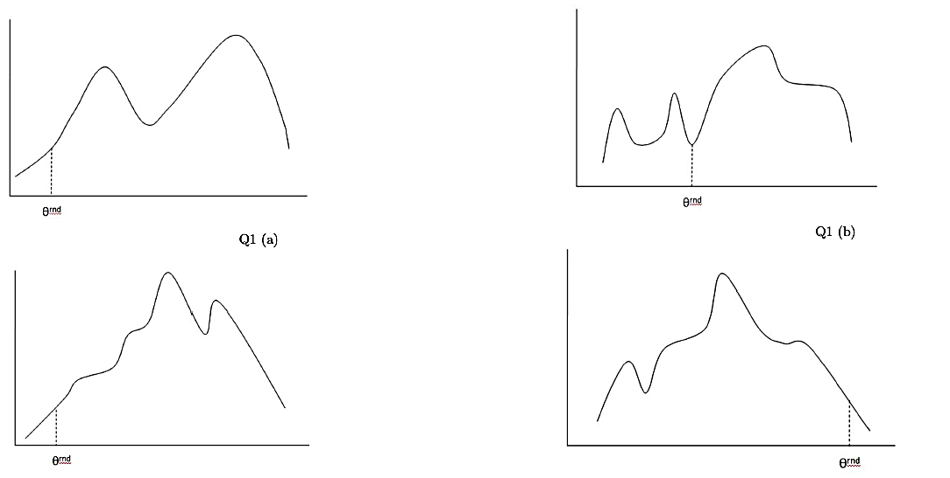
QUESTION 10
In each of the options the diagram contains a log likelihood function for a particular problem as well as an initial value of the parameter used in the execution of the EM algorithm. In which of the given scenarios will the EM algorithm be able to achieve the global maximum?
(a)
(b)
(c)
(d)
SOLUTION 10
In option (a), (b) and (d) the EM will struck in local maxima. Hence (c) is the correct answer
CORRECT ANSWER 10
c)

